Slide 1

One little garden
Anna Šturmová
Barbora Hejnová
Eliška Jansová
17th May 2018
School national geography

Slide 2

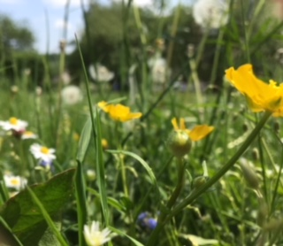
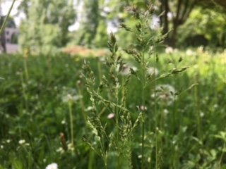
One little garden
Everything about flowers starts with common grass, which is not so interesting, but it‘s also important.
You can see there, that grass with some flowers can be sometimes really beautiful too.

Slide 3
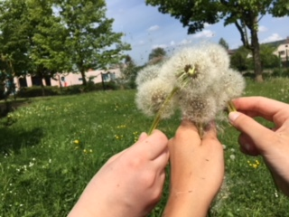
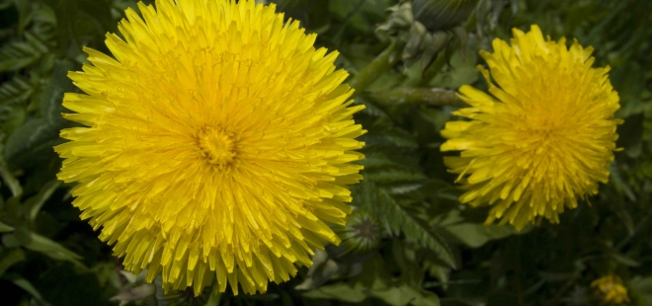
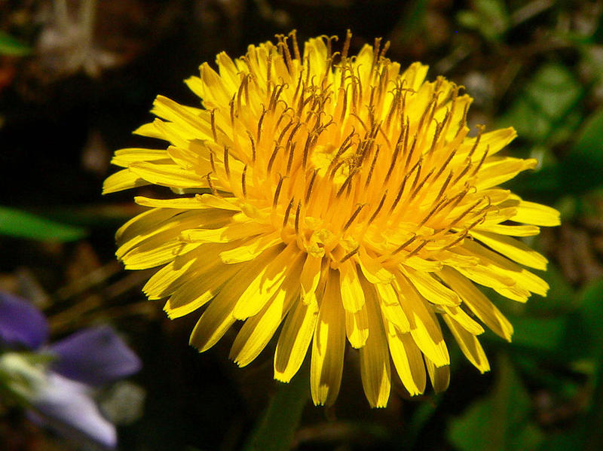
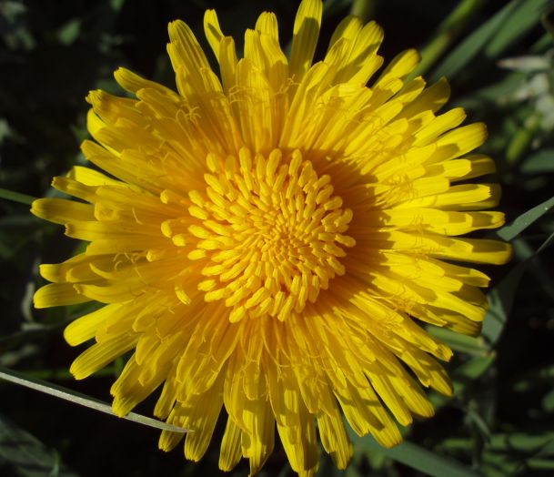
One little garden
There are dandelions, which are everywhere around the world .
When they are out of bloom, they can do amazing things...

Slide 4
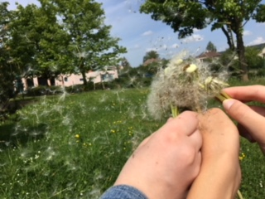
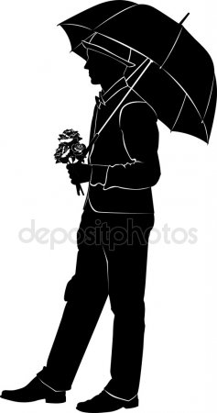
One little garden
...seeds can just fly away like little planes.
Children are exciting with it and they think, that seeds are small gantlemen with small umbrellas in real.

Slide 5
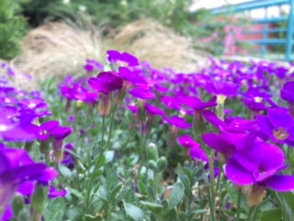
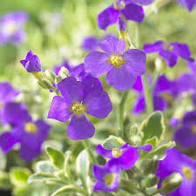
One little garden
There is Silberrand, which is a member of Aubrieta family.
They have amazing violet petals, which just fascinated us. So we took photoes of them and we put them to our project.

Slide 6
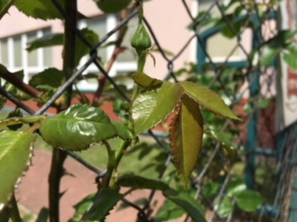
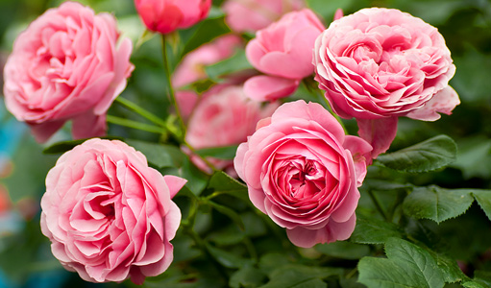
One little garden
This is a rose, more precisely a rose in bud. We have them next to our school, on a gate to our school garden.
Roses are interesting flowers, and everyone should know them, right? Who doesn´t know roses?

Slide 7
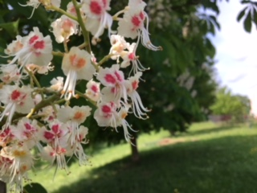
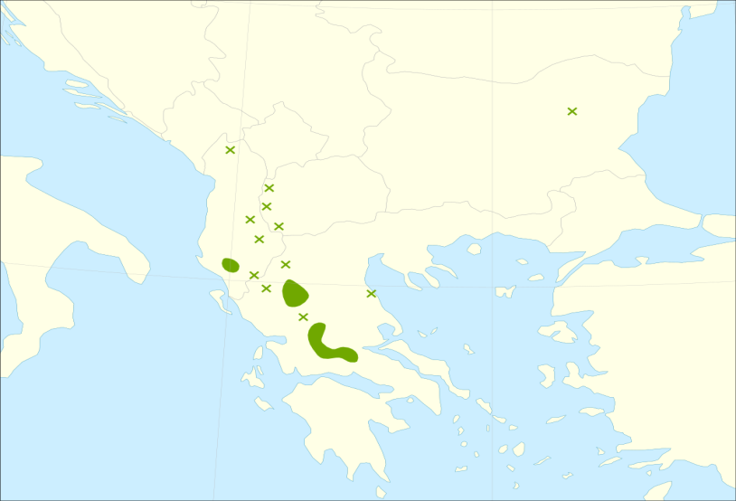
One little garden
This is Chestnuts tree, more precisely petals of Chestnuts tree. Once they will be chestnuts.
Chestnuts trees are around Greece, but they are in the Czech Republic too.

Slide 8
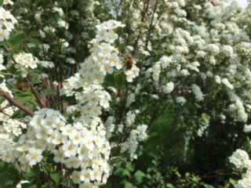
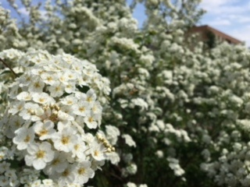
One little garden
This is Spiraea vanhouttei and if you look at it in depth you can see that there is a bee sitting on the bush.
Spiraea is in bloom every May and July.
It is planted in front of our school.

Slide 9
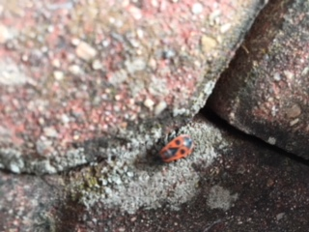
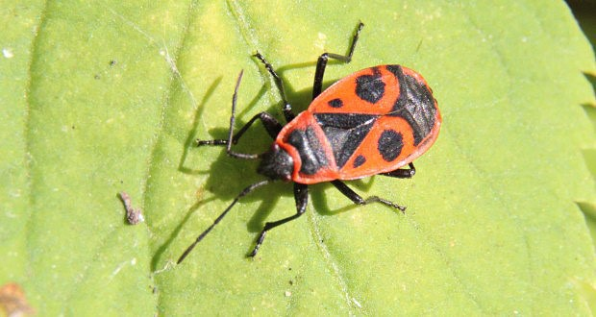
One little garden
This is pyrrhocoris apterus. They are everywhere around our school.
They are red with black shapes on their backs.
They are little and they could be cute for someone.

Slide 10
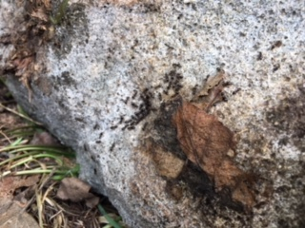
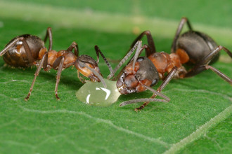
One little garden
They are black ants.
As you can see on the picture ants are just amazing, universally gifted and diligent creatures.
They live in anthills, which are perfect buildings. They work together in groups and they can carry their food to their homes.

Slide 11
One little garden
Thank you very much
for your watching and listening.
And of course we thanks our teachers.
They helped us with everything.
So thanks and goodbye.
☺

